Slide 1

Chapter 5
The Power of Language

Slide 2
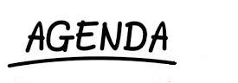
Layers of Language
Symbolic Nature of Language
Principles of Verbal Communication
Functions of Symbols
Speech Communities
Improving Verbal Communication

Slide 3
Layers of Language
Language
Semantics
Morphology
Phonetics
Pragmatics
Syntax

Slide 4
Layers of Language
Phonetics: Production and perception of sound
Morphology: How sounds combine to make words
Syntax: Ordering words to make sentences
Semantics: Literal meaning of words and sentences
Pragmatics: Meaning of sentences in context

Slide 5
The Symbolic Nature of Language
Symbols are arbitrary, ambiguous, and abstract representations of other phenomena

Slide 6
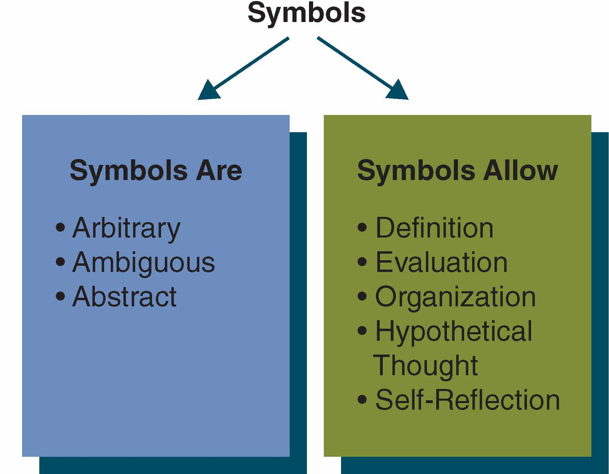

Slide 7
Principles of Verbal Communication
Language and Culture Reflect Each Other
The Meanings of Language Are Subjective
Language Use Is Rule-guided:
Regulative Rules – regulate interactions
Constitutive Rules – define meaning of communication
Communication Devices Shape Meaning

Slide 8
Communication Devices
We format communication to decide what it means
Speed
Pacing
Pausing
Overlap
Interruption

Slide 9
Functions of Symbols
Symbols Define
Labels Shape Perceptions
Labels Can Totalize
Labels Affect Relationships
Symbols Evaluate
Values in Language Reflect and Shape Perceptions
Language Can Be Negatively Loaded
Language Can Degrade Others

Slide 10
Functions of Symbols (cont’d)
Symbols Organize Perceptions
Language Allows Abstract Thought
Language Can Stereotype
Symbols Allow Hypothetical Thought
We Can Think Beyond Immediate, Concrete Situations
We Live in Three Dimensions of Time
We Can Foster Personal Growth
Symbols Allow Self-Reflection
Self-Reflection Allows Us to Monitor Communication
Self-Reflection Allows Us to Manage Our Image

Slide 11
Speech Communities
A speech community exists when people share norms about how to use talk and what purposes it serves. (Labov, 1972)

Slide 12
Speech Communities (cont’d)
Gender Socialization
Social Class
“Race”
Ethnicity
Disability
Sports
Others

Slide 13
Guidelines for Improving Verbal Communication
Engage in Dual Perspective
Own Your Feelings and Thoughts
Respect What Others Say about Their Feelings and Thoughts
Strive for Accuracy and Clarity

Slide 14
You Language and I Language
☹
Examples of You-Language
☺
Examples of I-Language

Slide 15
Power of Words
Give examples of how words can be powerful:

Slide 16
Summary
Layers of Language
Power of Words
Symbolic Nature of Language
Chapter 5
Improving Verbal Communication
Principles of Language
Speech Communities
Functions of Symbols

